Slide 1
Security Engineering CSE 3SE/CSE 5SE Instructor: Sambuddho Chakravarty
(Semester: Winter 2015)
Week 6: Feb 10 – Feb 13
Lecture 8

Slide 2
Dynamic Memory Management
C standard memory management function –
void *malloc(size_t size)
void *realloc(void *p, size_t size)
void *calloc(size_t memb, size_t size)
aligned_alloc(size_t alignment, size_t size): Allocates ‘size’ bytes of space for an object whose alignment is specified by ‘alignment’. ‘Size’ must be integral of ‘alignment’.
void free(void *ptr)
void *alloca(size_t size): Allocates from stack by simply adjusting the stack pointer. Fast but deprecated in most BSD and GNU based systems.
Variable Length Arrays: VLAs (C99).
OS based memory allocation – brk() and sbrk()
malloc() uses these internally.

Slide 3
Alignment – A Very Quick Guide
Strict definition: The integral number of bytes between successive addresses at which given objects can be allocated.
Intel x86_32:
- Each object must be self-aligned: 32-bit object must begin at addresses that are multiples of 32-bits, 16-bit objects must begin at address that are multiples of 16-bits, 8-bit objects can begin anywhere.
- structs/unions have the alignment of their most restrictive member.

Slide 4
Common C Memory Management Errors
Initialization Errors: Assuming that the allocated function initializes the memory. E.g. falsely believing that malloc() initializes the memory to 0s. Exploited in the 2003 Solaris 2.0 tar program vulnerability.
Program allocated memory for accessing the /etc/passwd file. The memory was free()-ed and then later again re-malloc()-ed for the Tar program and it leaked /etc/passwd file contents.
Neither malloc() nor free() initialize or clean up the memory.
Solution:
malloc() + memset()
calloc()

Slide 5
Common C Memory Management Errors
Return value failures:
What if more memory is requested than can be allocated – physical+swap.
Once all Vmem is allocated the allocation fails.
C memory functions return NULL pointer if allocation failed.
Dereferencing Null or Invalid Pointers:
Generally dereferencing NULL pointer leads to segmentation fault.
In many systems – Cray supercomputer, various embedded systems memory location 0 was used…

Slide 6
Common C Memory Management Errors
Referencing freed memory: Reference memory after free() has been called.
(unsafe way)
for(p=head;p!=NULL;p=p->next)
free(p);
[Brian Kernighan and Dennis M. Ritchie. The C Programming Language, Second Edn., 1988]
(safe way)
for(p=head;p!=NULL;p=q){
q=p->next;
free(q);}

Slide 7
Common C Memory Management Errors
Double free() errors
Memory leaks – Allocated dynamic memory is not freed. Might not be very obvious e.g. memory allocated at the beginning but not freed.
Can be exploited by an attack who may identify external inputs that could cause memory to be allocated but ever freed – e.g. input longer than what can be handled by dynamic memory allocated by malloc().
Zero length allocation – What happens when you do – malloc(0) or realloc(p,0).
Returns pointer to a zero length block – merely a pointer. Writing to these pointers corrupt the internal structure used to handle malloc() and free()
Realloc() dealocates the old object and returns pointer to a new object of the specified size. However, if memory of new object cannot be allocated, it does not deallocate the old object.
Implementation dependent behavior of malloc(0) and realloc(p,0).

Slide 8
How malloc() Works
HEAP
Traditional heap organization
for malloc() and free().
Carves out a large chunk of heap.
Unallocated data arranged as free
list (linked list).
Each chunk tagged with a ‘size’
prefix.
HEAD
64
next
128
next

Slide 9
How malloc() Works
HEAP
HEAP
malloc(96)
HEAD
HEAD
64
64
next
next
128
Allocated to
malloc()
next
96 bytes
128
next

Slide 10
How malloc() Works
HEAP
HEAP
free(p)
Chunk added back to
free-list (at the head).
HEAD
HEAD
64
128
next
next
64
next
96 bytes
128
128
next
next

Slide 11
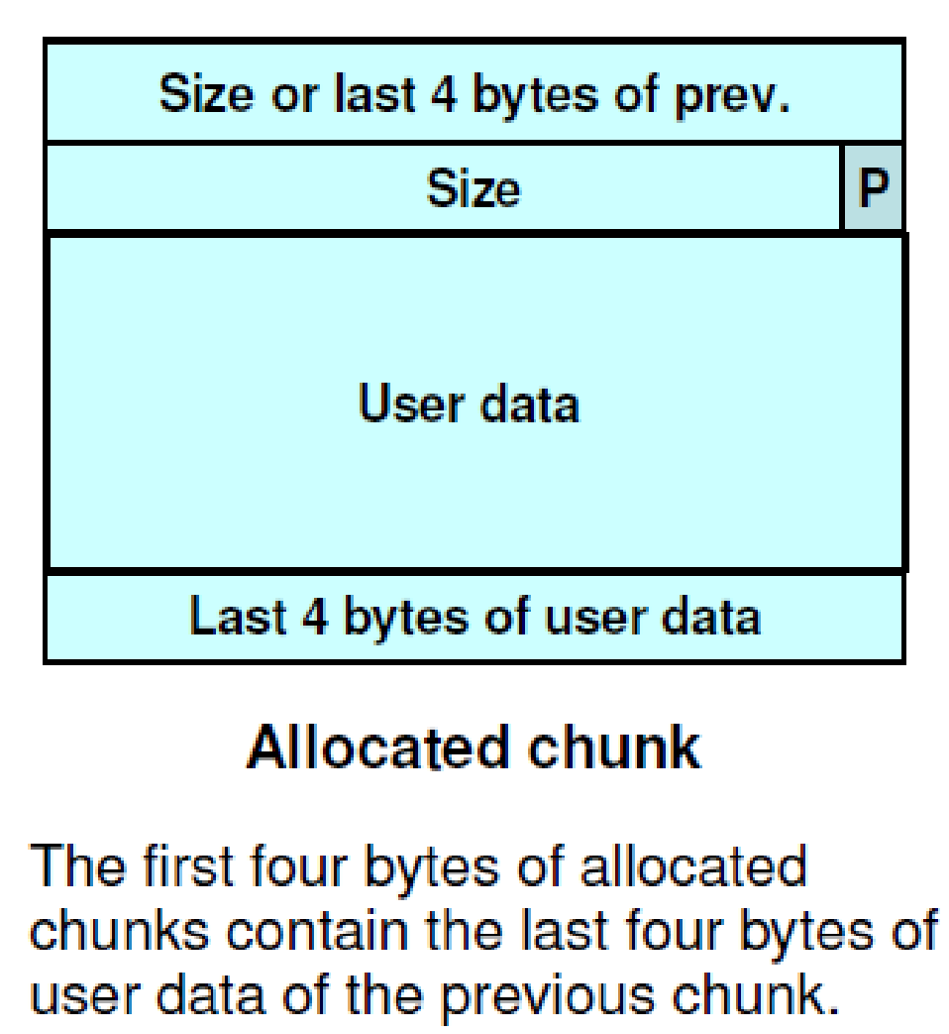
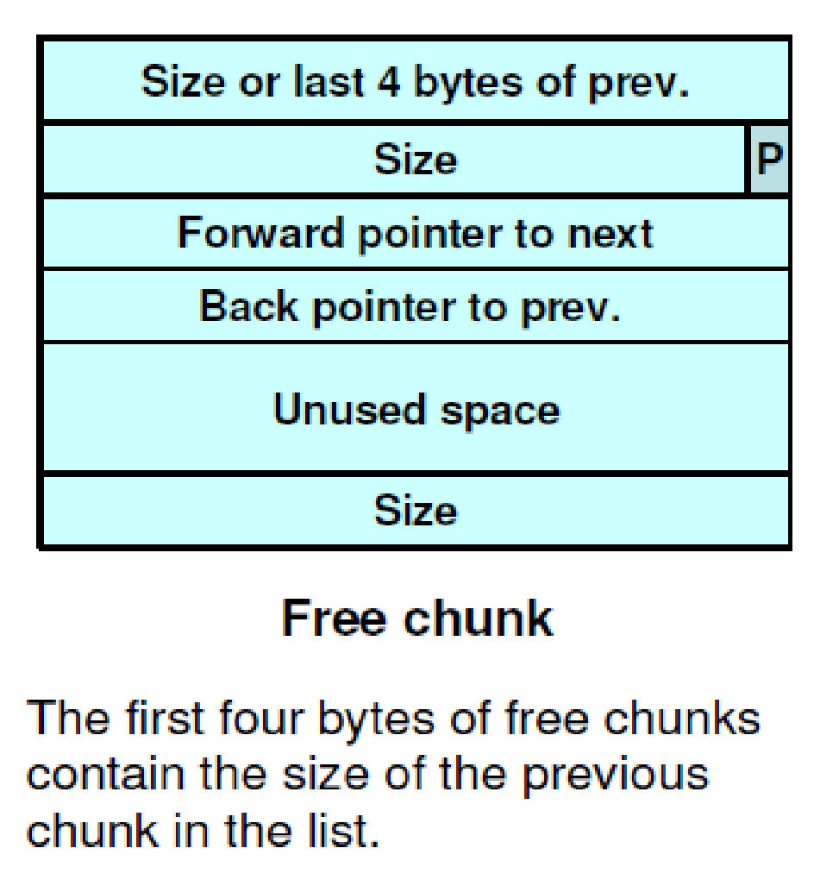
Doug Lea’s Memory Allocator (dlmalloc)
Used in most modern GNU/Linux libc implementations.
Free chunks organized into doubly linked lists (similar to traditional malloc).

Slide 12
PREV_INUSE Bit:
Indicates weather the previous bit is allocated or not.
Chunks sizes are always 2-byte multiples – the LSB (PREV_INUSE) being 0.
PREV_INUSE == 1 . Chunk allocated.

Slide 13
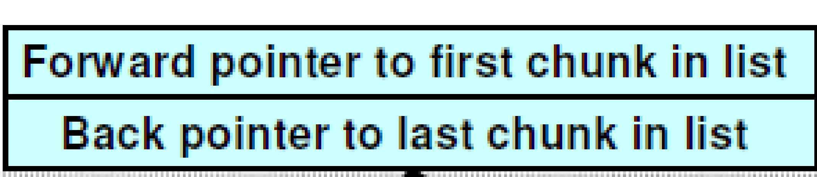
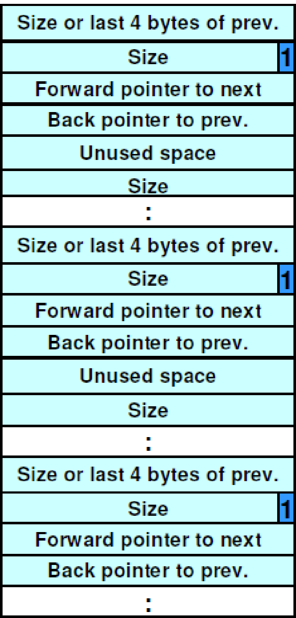
Free List of dlmalloc

Slide 14
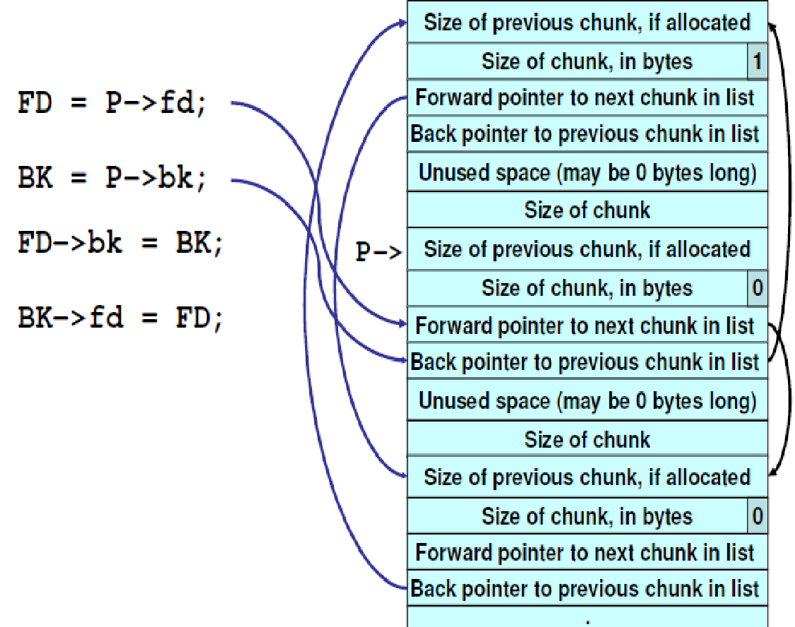
Buffer Overflow through Heaps
Unlink technique:
The unlink macro:
#define unlink (P, BK, FD) {
FD = P->fd; \
BK = P->bk; \
FD->bk = BK; \
BK->fd = FD; \
}
Unlink macro called when free()-ing
a chunk of memory – specifically
when consolidating chunks.

Slide 15

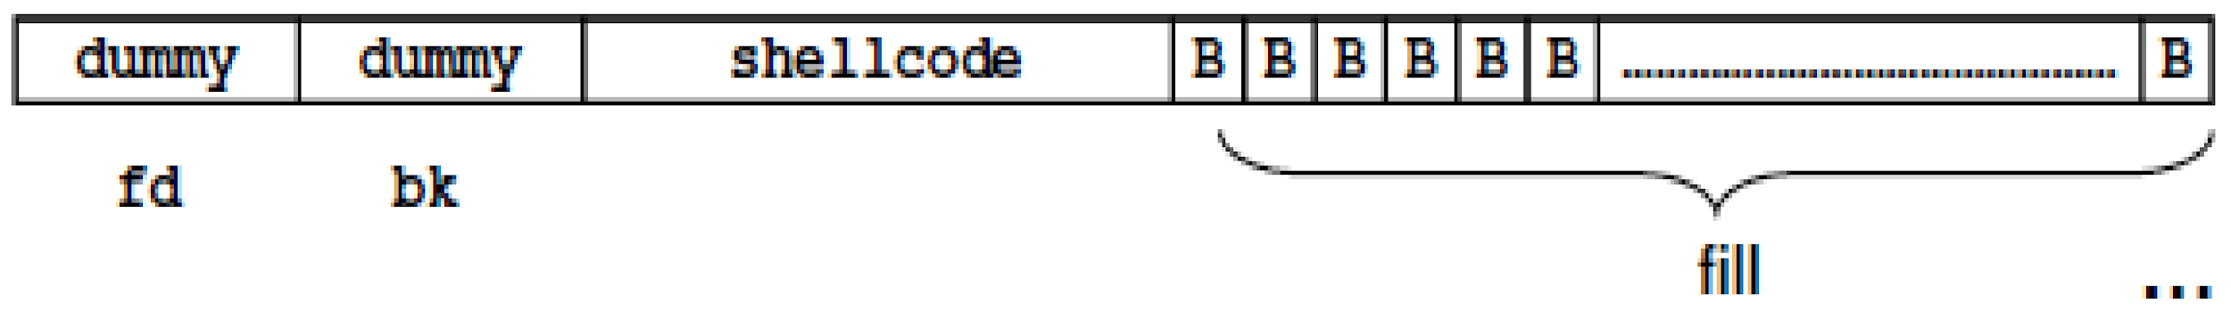
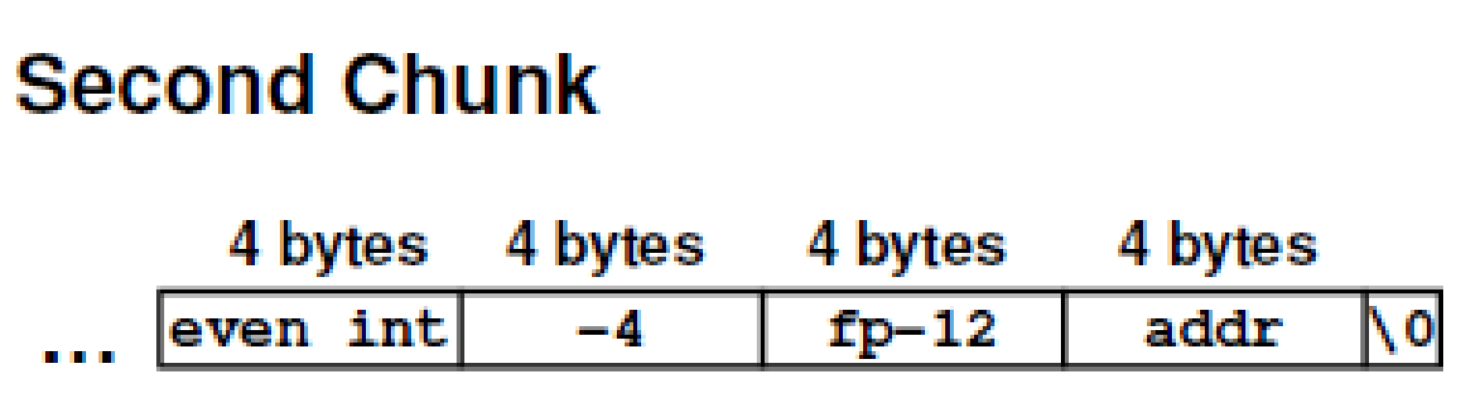



Buffer Overflow through Heaps
void main(int argc, unsigned char **argv)
{
char *first,*second,*third;
first = malloc(666);
second = malloc(12);
third = malloc(12);
strcpy(first,argv[1]);
free(first);
free(second);
free(third);
return 0;
}

Slide 16
Buffer Overflow through Heaps
argv[1] is very large and overflows the “chunk boundary” and writes over the prev_size, size, fd, bk in the next chunk.
Unlink() macro allows writing the arbitrary value (addr) to arbitrary memory location (fp).
Size of the second heap-buffer is -4 (0xfffffffc).
The current (second) chunk looks like the third.
Effective operation:
FD = P->fd;
BK = P->bk;
FD->bk = BK; // *(P->fd+12)= BK
BK->fd = FD; // *(P->bk+8) = FD
addr could be address of the shellcode and the fp could be the return address on the stack or some functions address obtained from the GOT table.
Replacing GOT address works only in Linux and not in Windows.

Slide 17
Preventing Against Heap Based Attacks
Adding canary in the chunk structure – managed by the heap memory management structure.
struct malloc_chunk{
INTERNAL_SIZE_T magic; // Canary generated checksum // f(chunk header,pseurandom // seed)
INTERNAL_SIZE_T __pad0;
INTERNAL_SIZE_T prev_size;
INTERNAL_SIZE_T size;
struct malloc_chunk *bk;
struct malloc_chunk *fd;
};

Slide 18
Phkmalloc()
Poul-Henning Kamp for FreeBSD.
Checks pointers passed to free() or realloc() is valid without dereferencing it
Can detect if a wrong pointer is passed, but can check if all pointers that were not returned by malloc() or realloc().
Determines whether a pointer is free or allocated and detects double free errors.
“Abort” option treats warnings as errors and exits the process when the malloc() detects problems.
Has been used to determine MM vulnerabilities and bugs in fsck, cvs, inetd.

Slide 19
Heap Randmization and Guard Pages
Similar to ASLR – used to randomize the address of blocks by randomizing the heap address returned by the OS.
Guard pages: Unmapped pages placed between all allocations of memory – throws SIGSEGV when accessed.

Slide 20
Tools – Electric Fense (efense) and Valgrind
Efence:
- Detects buffer overflow or unallocated memory refs.
- Implements guard pages.
-free()-ed memory made inaccessible and when a program accesses it, it throws SIGSEGV.
Valgrind:
Allows a programmer to profile and debug executables.
-Synthetic x86_64 CPU instructions, series of profiling and debugging tools for similar purposes.
-Memcheck:
-Checks for memory errors related to touching locations that shouldn’t (e.g. overrunning heap boundaries).
-Using values before initialization.
- Incorrect freeing of memory – double free() errors.

Slide 21
Mid-term review
Recap of Topics covered so far
Traditional MLS systems – Bell La Padula and Biba Model.
Saltzer and Schroder Model.
Advantages and disadvantages.
Access controls
Discretionary access controls – Linux/Windows.
ACLs
Mandatory access controls and RBACs – SELinux.
Stack Smashing Attacks
Program flow execution.
Stack corruption and changing the return address of functions.
Shellcode and stack smashing attacks.
Format string vulnerabilities
Basics of format strings.
How to view the stack contents.
How to write to arbitrary addresses.
Dynamic memory allocation vulnerabilities
Basics of dynamic memory allocation functions in C library.
How malloc works and how it can be exploited.

Slide 22
Mid-term review
What to expect in the exam
About 15-20 MCQs. No negative points.
2 or 3 design questions (subjective style).

Slide 23
Assignment 3
Shellcode : Write a shellcode that prints “Hello World!” and then exits. It should work in most x86_64 systems.
Hint: You would need to write the output to the screen using write()
system call.
Placing the shell code on stack: Write a C program which when exits, prints out the above shellcode.
Program flow redirection: Using gdb debugger determine how you could redirect the flow of a program to another address.
Due date: March 10, 2015

